Slide 1

MY SOLUTION TO THE AMAZON TASK 1 CODING CHALLENGE
By favour eze

Slide 2
INTRODUCTION
The Task requires that I develop an algorithm for Amazon’s self driving delivery vehicles to get from a starting point to a delivery point whilst avoiding obstacles.
My proposed solution gets the vehicles from a chosen starting point to the delivery point, avoids the obstacles and identifies the shortest path to achieve this solution.
My language of choice is PYTHON Language. In my Python environment I will install some modules required to successfully achieve my proposed solution.
Limitation is that I am a newbie in programming, but I am willing to learn.

Slide 3
PSEUDOCODE
Install the Pathfinding module and import the classes as shown below
Create the 10x 10 Grid and assign to the matrix variable. Cell Value represents whether there’s an obstacle. 1 stands for no obstacle, 0 stands for Obstacle

Slide 4
PSEUDOCODE
Select a start point(0,0) and delivery point(9,9) and use the Astar finder method to create a finder and use the finder to get from one point to another
Print the shortest path and number of runs

Slide 5
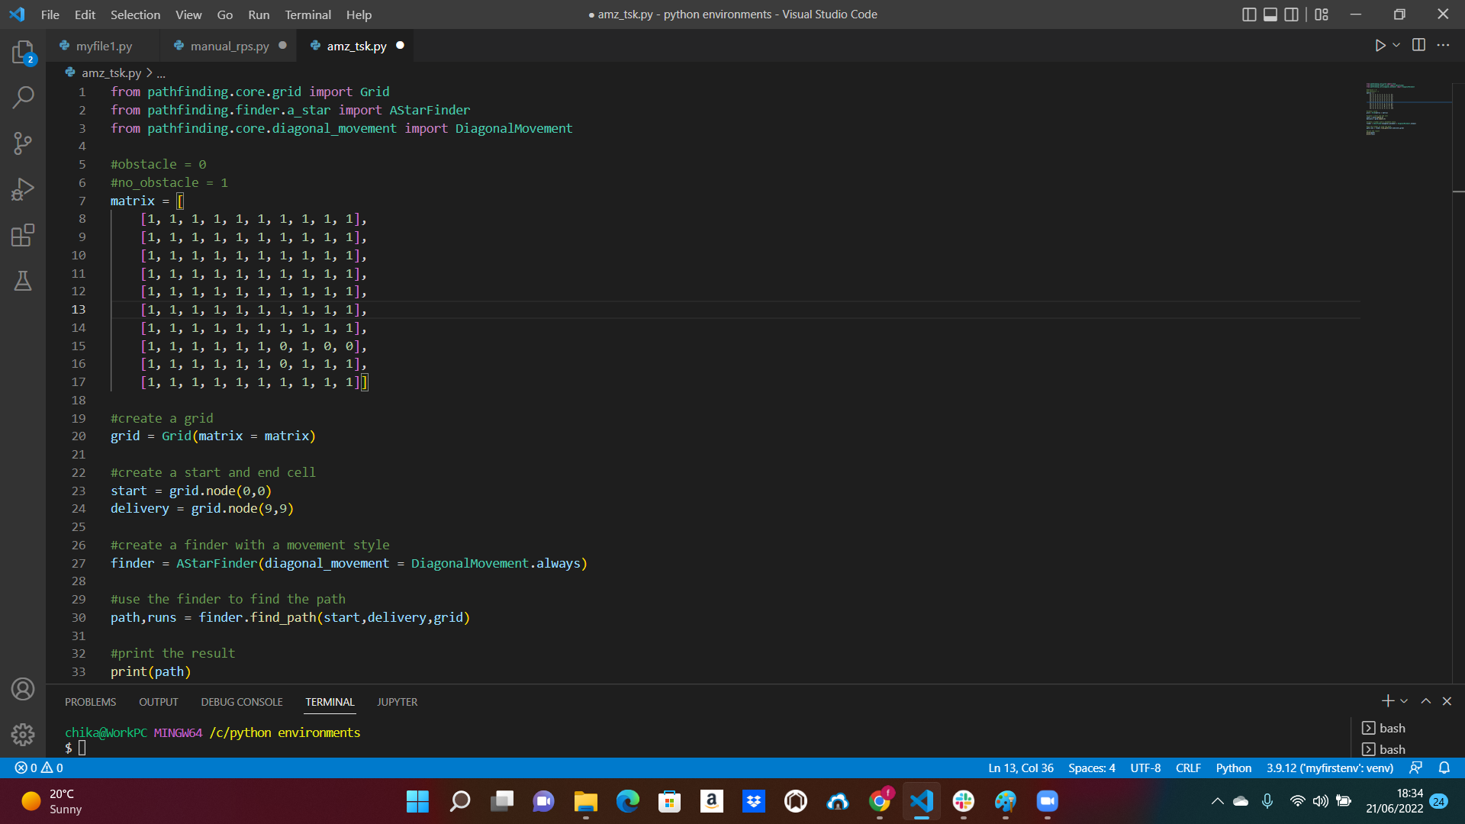
PHASE 1 source code

Slide 6
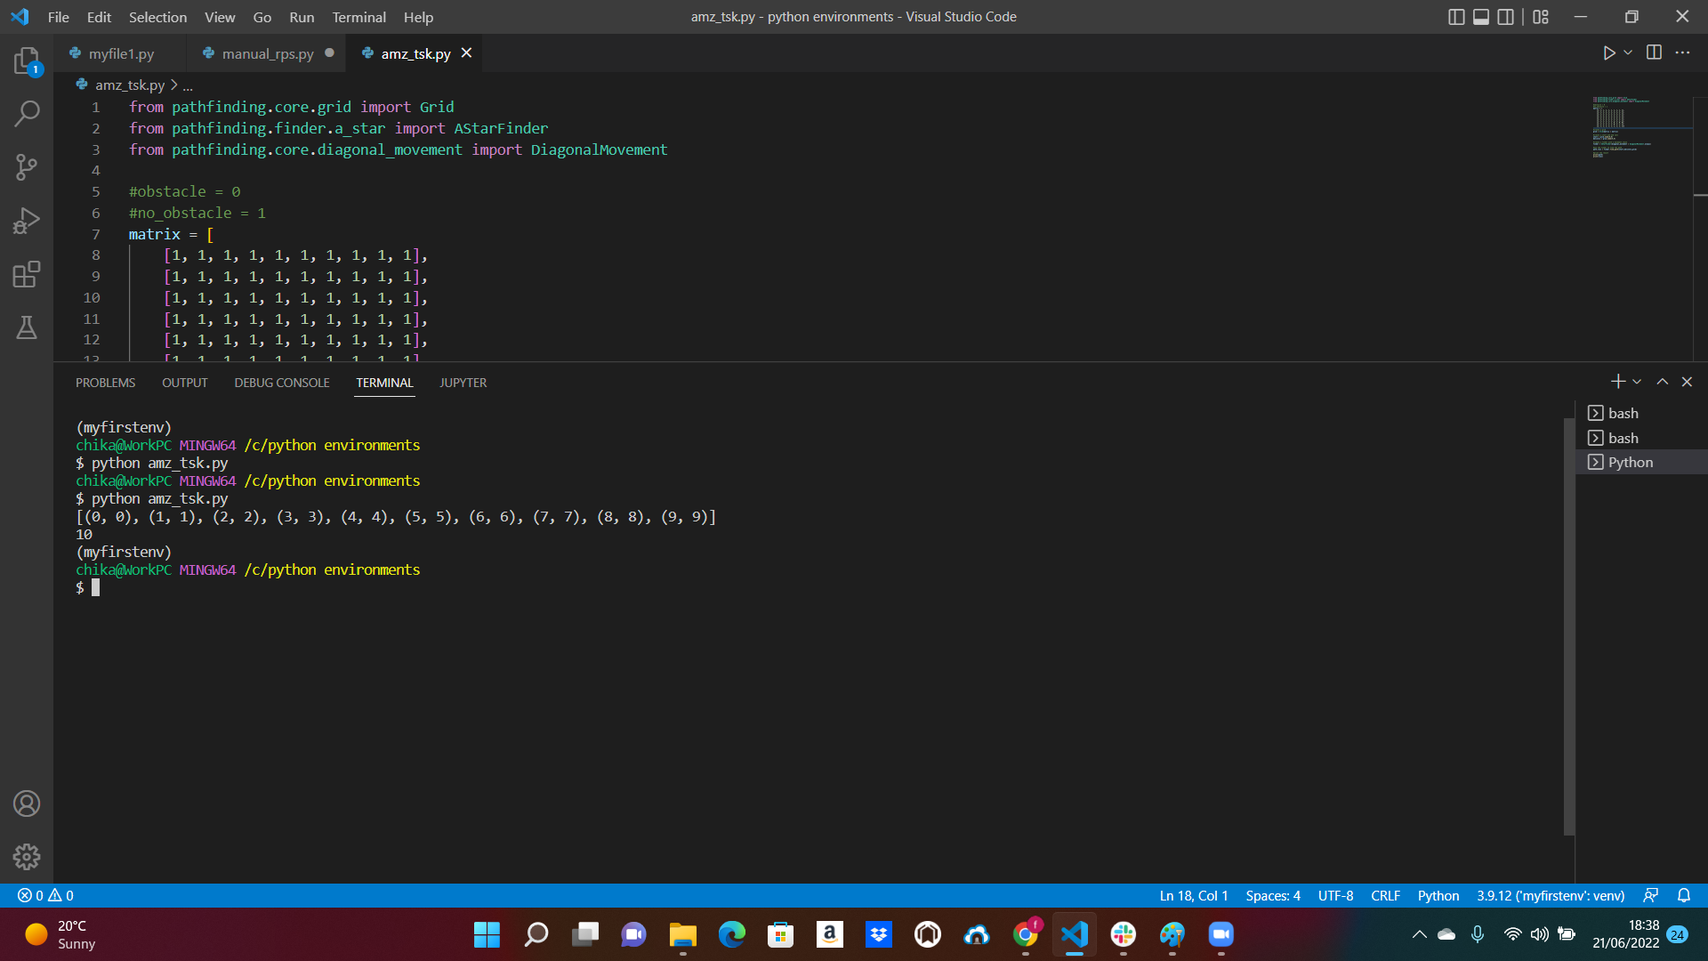
PHASE 1- OUTPUT

Slide 7
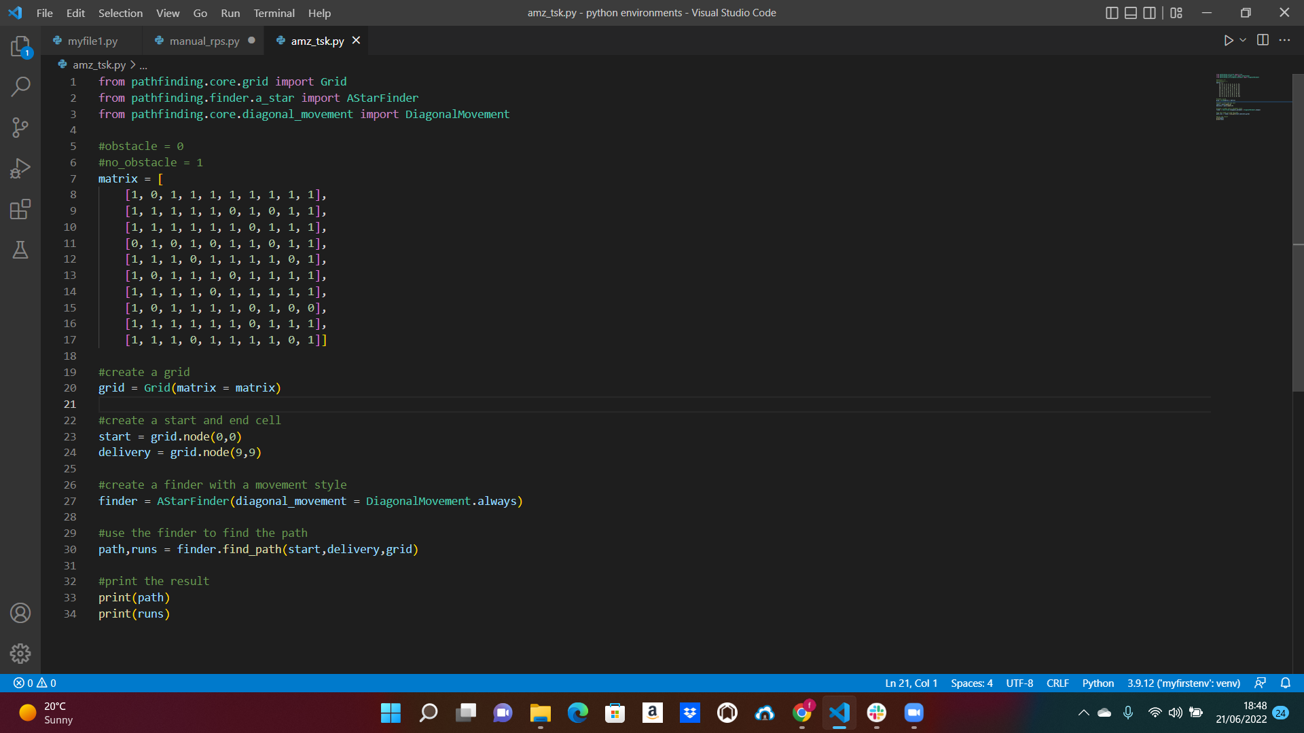
PHASE 2 source code

Slide 8
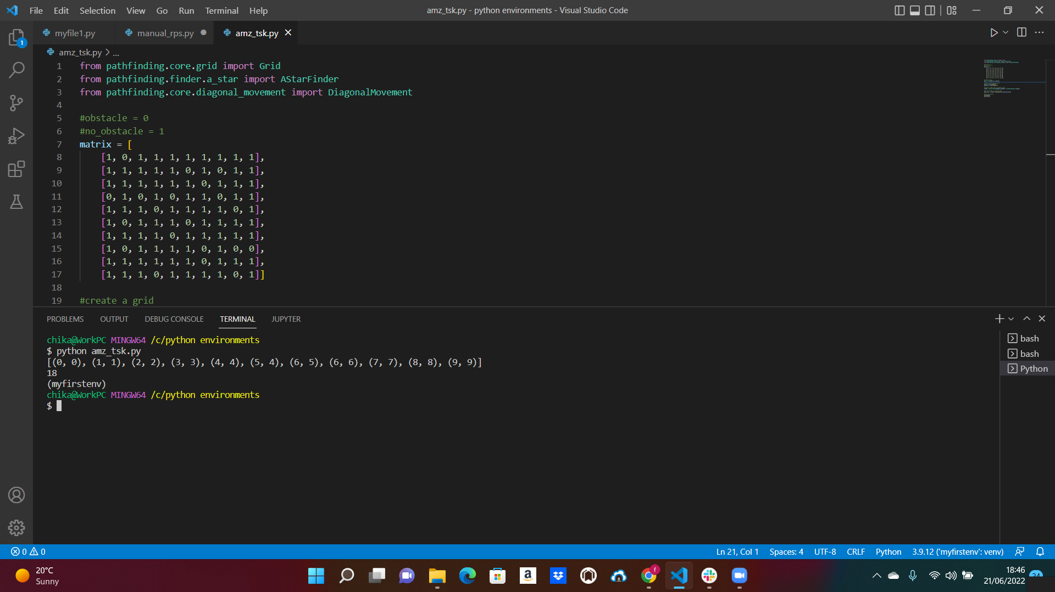
PHASE 2- OUTPUT

